Slide 1

Web Development
Lecture 01
Mr. Niaz Mir Khan
Lecturer in Computer Science
__________________________________________________
Department of Computer Science
Govt: Degree College Jamrud, District Khyber
1

Slide 2
.
Internet
Vs
Web (World Wide Web or www)

Slide 3
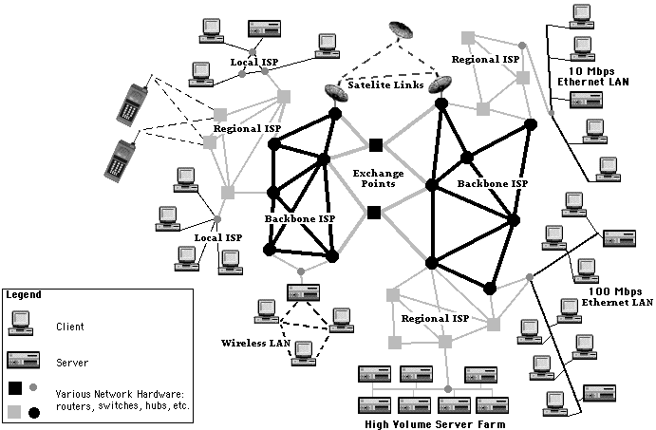
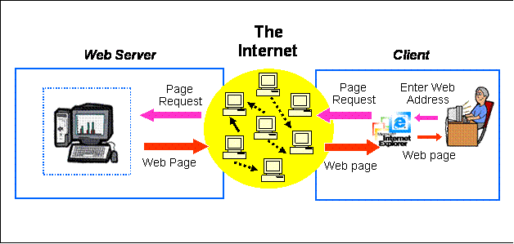
.
  Internet is the network of networks that connects computers worldwide.
  Web is the system that uses HTTP protocol to transfer information between computers.
    webpages, text, multimedia etc

Slide 4
Internet - simply
Internet is network of networks throughout the world
Computers in each network is able to communicate with other computers in other network for specific services.
  e.g. ISP is a network
Different network applications can run on Internet
    Web (HTTP)
    Email (SMTP)
    File Transfer services (FTP)

Slide 5
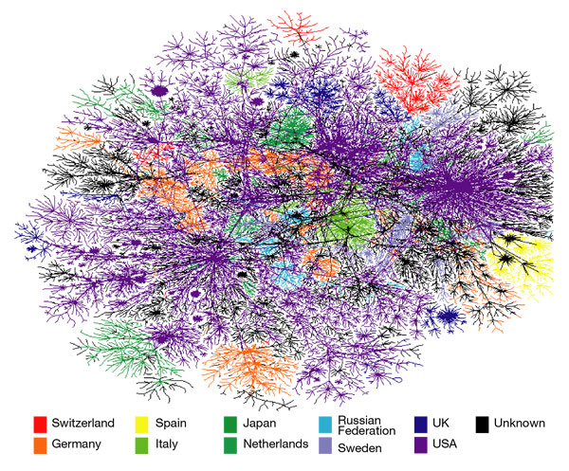
What does the Internet look like?
No map exists of the entire Internet, but these lines show the paths an e-mail might take across some of the largest networks.
Source: http://www.nature.com/nature/journal/v406/n6794/fig_tab/406353a0_F1.html

Slide 6
The Web: World Wide Web or www
The Web is the system that uses HyperText Transport Protocol (HTTP) protocol to transfer information between computers.
    Information in the form of webpages
    Information transfer requires a client (web browser) and a server (web server) having information in the form of webpages.
The Web is the collection of server computers hosting webpages.
The World Wide Web (WWW) is a system for accessing and sharing information over the Internet using web pages. It was invented by Tim Berners-Lee in 1989 and launched in 1991.

Slide 7
.
Here's a breakdown of what it involves:
Web Pages: Documents written in HTML (Hypertext Markup Language) that can contain text, images, videos, and links to other pages.
Web Browsers: Software like Chrome, Firefox, or Safari that lets you view and interact with web pages.
Web Servers: Computers that store and send web pages to users when requested.
URLs: Uniform Resource Locators — the addresses you type into a browser (like https://www.wikipedia.org) to visit a website.
The World Wide Web is just one part of the Internet. The Internet includes other services too, like email, file sharing, and messaging.

Slide 8
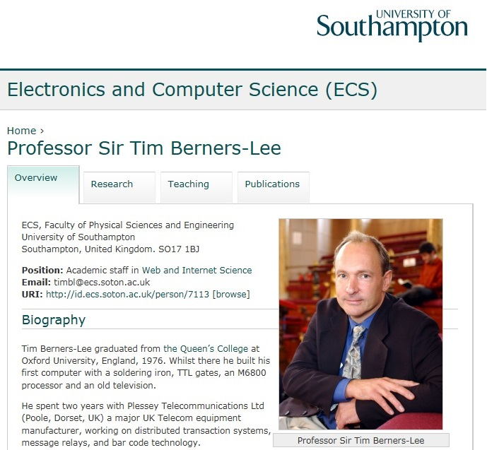
World Wide Web ( or www)
Tim Berners-Lee invented the World Wide Web in 1989.

Slide 9
.
Tim Berners-Lee invented the Web while at CERN, the European Particle Physics Laboratory, in 1989.
He wrote the first web client (browser) and server in 1990 and specifications of URIs, HTTP and HTML.
    Info.cern.ch was the address of the world's first-ever web site
    The first web page address was http://info.cern.ch/hypertext/WWW/TheProject.html

Slide 10
Real-world Analogy
ISP = Your electricity provider (e.g., they supply you the service to your home)
Internet = The entire power grid/network (i.e., the infrastructure that distributes electricity)
WWW = The appliances you plug into electricity (e.g., a TV or microwave; websites you visit using the Internet)

Slide 11

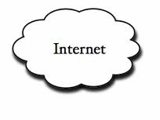

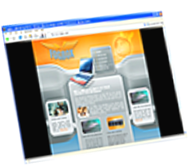
Web Architecture
Client request
Server response
Client running a Web Browser
HTML files
Server running Web Server Software (IIS, Apache, etc.)

Slide 12
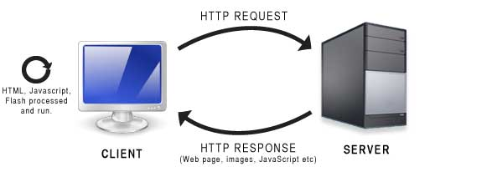
HTTP
Hypertext Transfer Protocol (HTTP)
HTTP is the protocol used by data communication for the World Wide Web.
  Web browsers and Web servers communicate through HTTP
HTTP is request and response protocol

Slide 13
HTML
HyperText Markup Language for writing web documents or webpages
    Hypertext: Hypertext refers to a piece of text that works as a link.
    Markup Language: It provides a way of writing layout information within documents, by putting commands or HTML tags ( <tagName>) around text.
A webpage is an HTML document
    An HTML document is a file that contains text and tags around different texts that describe structure, format and purpose for text or multimedia objects.

Slide 14
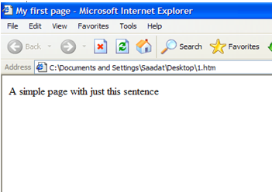
Tags in HTML
Tags are like <tagName>
When a browser opens an HTML file, the browser will look for HTML codes/tags in the text and use them to format and structure the text, multimedia or create links to other pages.
<HTML>
<HEAD>
<TITLE> My first page</TITLE>
</HEAD>
  <BODY>
  A simple page with just this sentence
  </BODY>
</HTML>

Slide 15
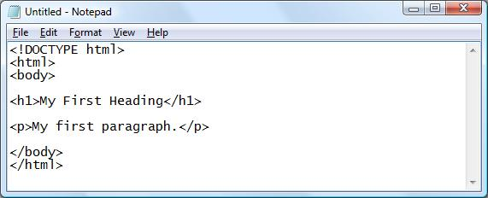
HTML editor – for writing HTML code
HTML code can be written in simple text editor like notepad in windows
You need to save the HTML code document with extension .html extension or an .htm (for instance "mypage.html").

Slide 16
WHY LEARN HTML?
It is possible to create webpages without knowing anything about the HTML.
Why learn HTML then??
  For server side programming / dynamic websites (e.g. displaying data from databases) you need to understand HTML code.

Slide 17
HTML Structure
<HTML>
<HEAD>
<TITLE> My first page</TITLE>
</HEAD>
  <BODY>
  A simple page with just this sentence
  </BODY>
</HTML>
  Simple first example:
  Use any text editor
  Type the code above (copy html code sometimes creates problem)
  Save the file in using extension .htm or .html
  Open in any web browser.

Slide 18
.
  HEAD section
    Info about the document
    Info in header not generally rendered in display window
    TITLE element names your Web page
      Title visible on top of browser.
    It can include meta tags which contain the key words used by search engines.
      e.g: <meta name= "keywords" content= "…..">
  BODY section
    Contains page content
      Includes text, images, links, forms, etc.

Slide 19
Common HTML tags categories
Text formatting
  Bold, font type/size/color, alignment (center,right,left)
  Paragraph, headers,
Links
Multimedia (audio/video)
Lists:
  Ordered lists
  Unordered lists)
Table:
  Tables are used a lot for structuring websites
Creating forms
  Text fields, buttons, drop down lists etc

Slide 20
Text formatting
Italics
  Emphasis (italics) style: <EM>text</EM>
  Older tag: Italics <i> and </i>
Bold
  Strong (bold) style: <STRONG>…</STRONG>
  Older tag: Bold <b> and </b>
Underlined
  <u> and </u>
All capital or BIG letters:
  <big> and </big>
All small letters:
  <small> and </small>

Slide 21
Font
Font face:
<font face=“Arial”>internet</font>
Font size from 1 to 7
<font size=5>and</font>
Font color
<font color= red>e-commerce</font>
<font size=5 color=red face=Arial>internet and e-commerce</font>

Slide 22
.
Line break
  <br>
  Enters a new line. Everything after this line will be displayed in new line.
  Horizontal line: <hr>
Tag for CENTER
  <center>text text text</center>
  This applies on everything between these two tags
  Images, tables, text, etc.

Slide 23
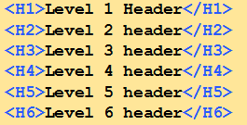
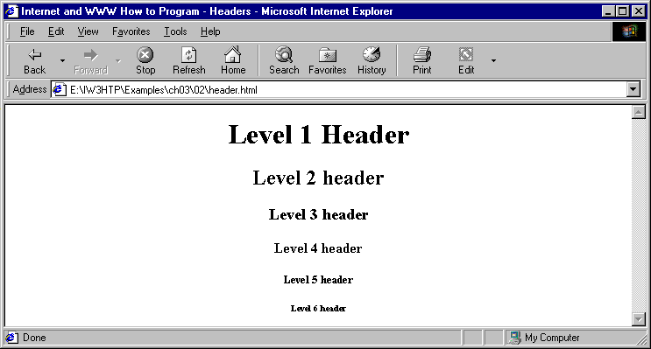
Heading
HTML provides 6 headings.

Slide 24
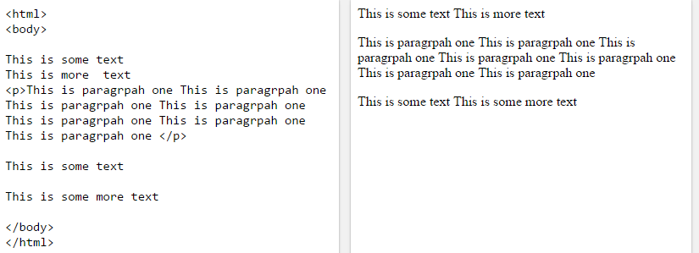
<p>
Paragraph: <p>
  Paragraph is started with new line and puts a new line at the end.
  <p> text text text </p>

Slide 25
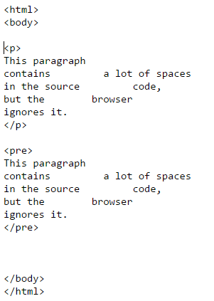
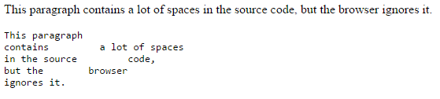
<pre> element defines preformatted text.

Slide 26
.
Text Alignment
  ALIGN = "center“
  ALIGN = "left “
  ALIGN = "right“
  Example:
  <p align=“center”> text text text </p>

Slide 27
1 <HTML>
2
3
4
5
6 <HEAD>
7 <TITLE>Internet and WWW How to Program - Welcome</TITLE>
8 </HEAD>
9
10 <BODY>
11 <H1 ALIGN = "center"><U>Welcome to Our Web Site!</U></H1>
12
13 <P>We have designed this site to teach
14 about the wonders of <EM>HTML</EM>. We have been using
15 <EM>HTML</EM> since <U>version<STRONG> 2.0</STRONG></U>,
16 and we enjoy the features that have been added recently. It
17 seems only a short time ago that we read our first <EM>HTML</EM>
18 book. Soon you will know about many of the great new features
19 of HTML 4.0.</P>
20
21 <H2 ALIGN = "center">Have Fun With the Site!</H2>
22
23 </BODY>
24 </HTML>

Slide 28
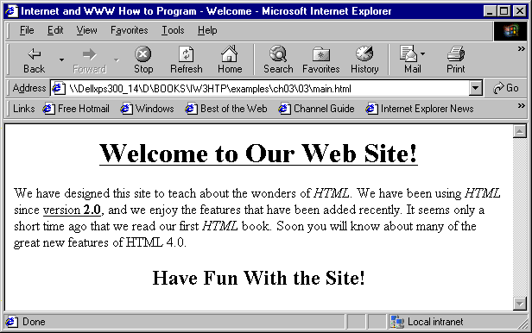

Slide 29
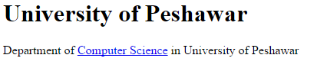
Links
<HTML>
<BODY>
<H1>University of Peshawar</H1>
Department of <A HREF=“http://www.dcs.edu.pk” >Computer Science</A> in University of Peshawar
</BODY>
<HTML>
Hypertext: Link to other pages
<a href= “http://www.linkAddress.com” > textLink </a>

